Slide 1
Mechanical Design of Robots

Slide 2

High School Competitions

Slide 3
In my opinion PSU students should build as good robots mechanically as the high school students

Slide 4
Looking just one on a good design can be very useful !
Why I did not come with this idea?
This is so smart and simple!
Oh, this can be done with Lego?
This can be done with Tetrix?

Slide 5
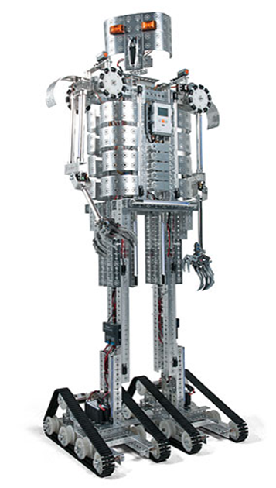

Slide 8
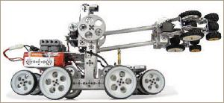
Show of Tetrix robot built by Pitsco

Slide 9
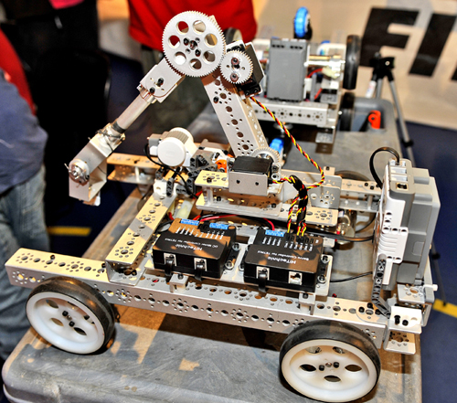
Mobile base with two controlled wheels and the arm, see use of gears.

Slide 10
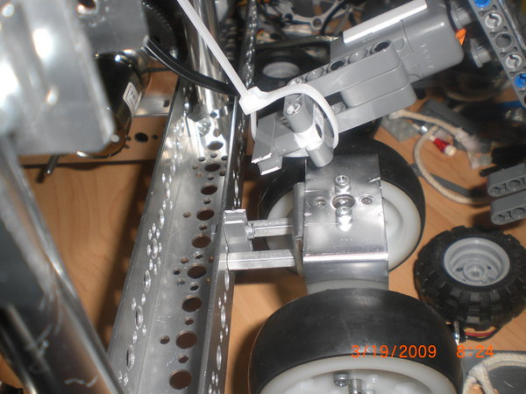
Attachment of components.

Slide 11
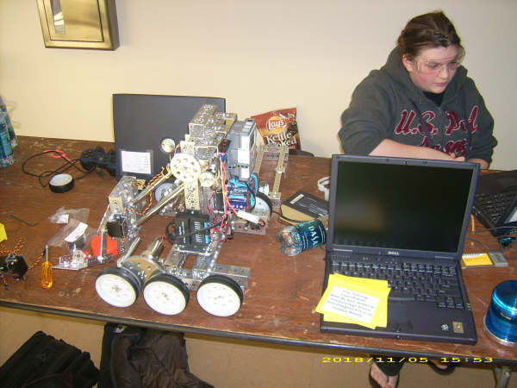
Three wheels on each side, but only one or two may be controlled. They can be also geared together
Arm with parallelogram

Slide 12
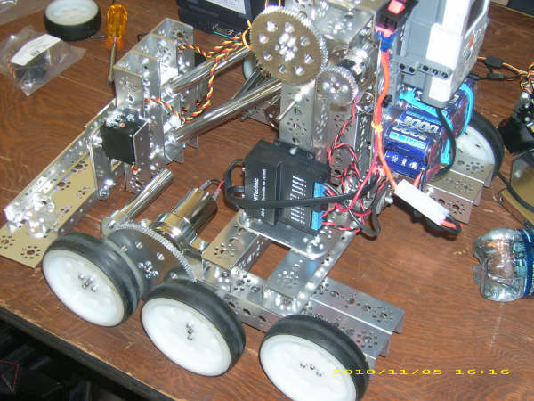
Robot with 6 wheels controlled by 2 DC motors

Slide 13
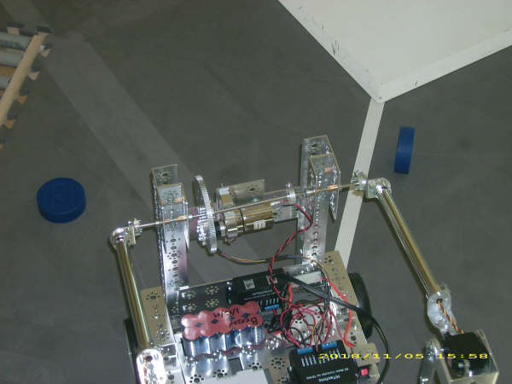
Arm construction. Batteries located on robot.

Slide 14
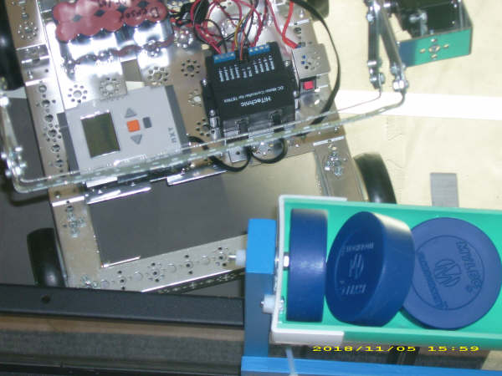
Pucks container. Motor controller on a robot. Brick.

Slide 15
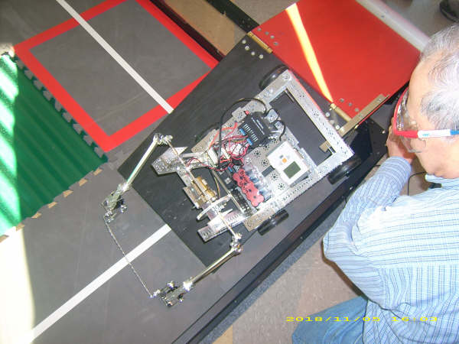
Robot from top. Note the arm to push pucks.

Slide 16
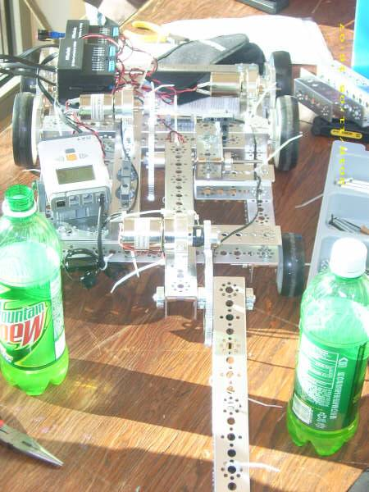
Another idea for arm construction and attachment to robot’s body

Slide 17
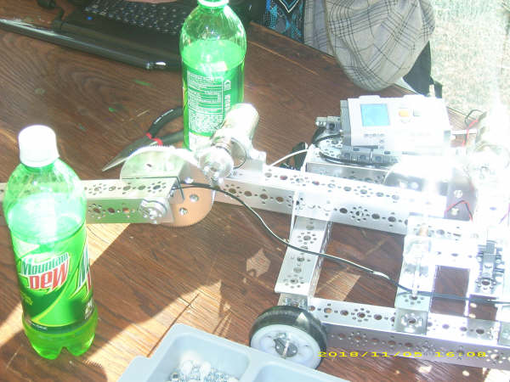
The same robot. Using DC motor on the arm

Slide 18
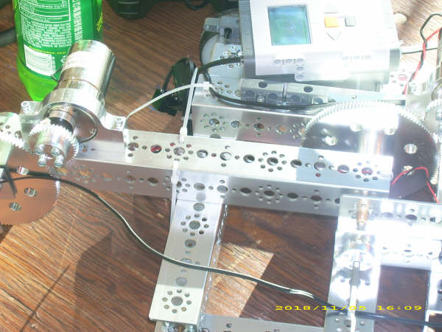
More details of the same robot

Slide 19
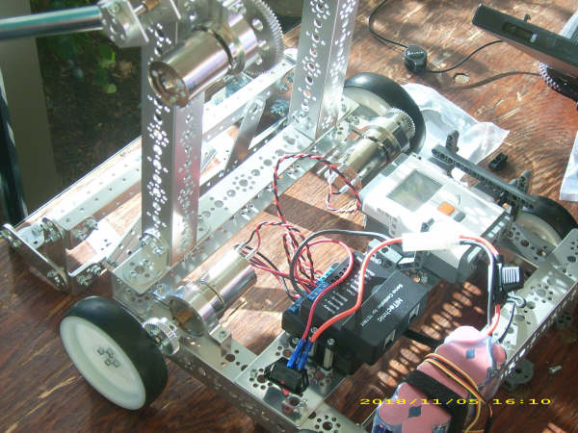
One more idea to construct the arm. Different wheel mechanism.

Slide 20
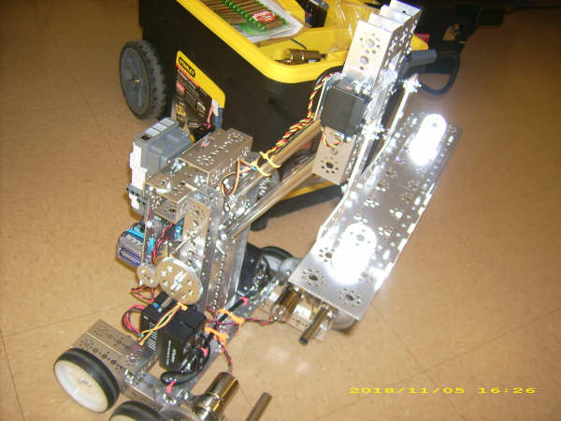
This design has lighter body and large arm. Stability problems, center of weight is high.

Slide 21
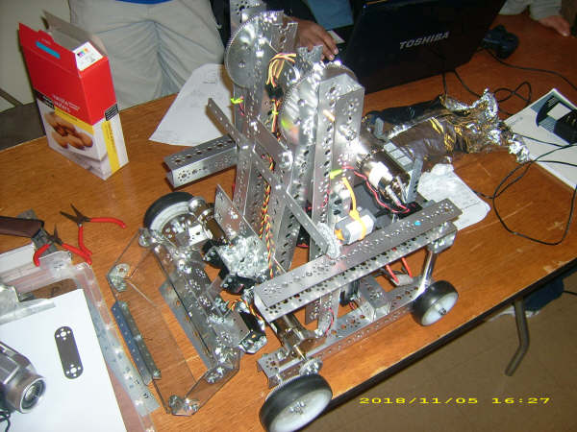
Two controls on wheels. Large arm

Slide 22
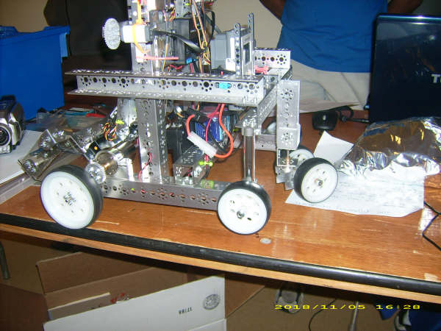
Strange design of controlled wheel plus four wheels

Slide 23
You can use similar construction for the caster (free) wheel

Slide 24
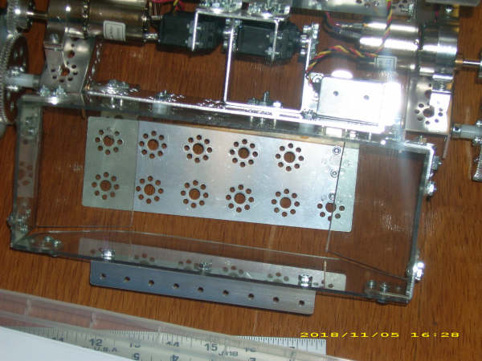
Details of puck container

Slide 25
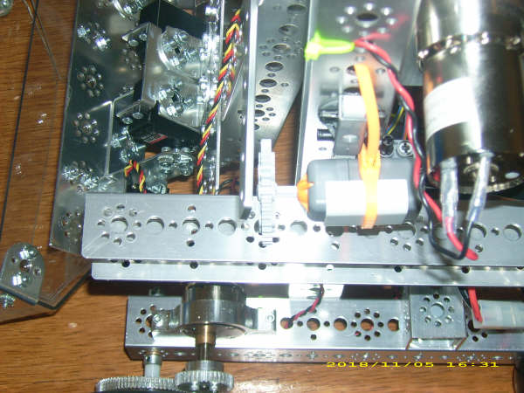

Slide 26
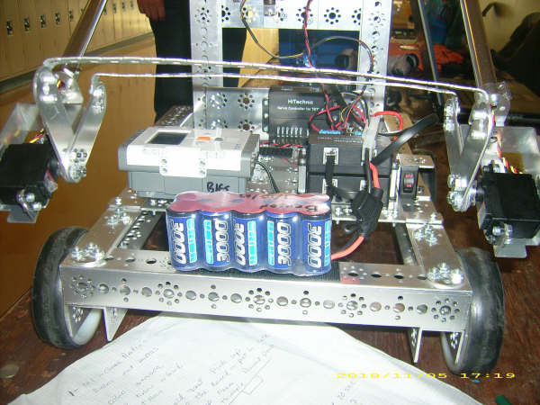
Arm construction

Slide 27
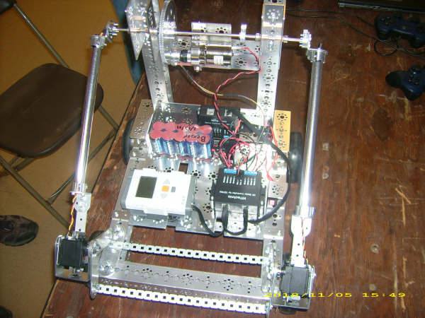
Please observe the construction of the arm.

Slide 28
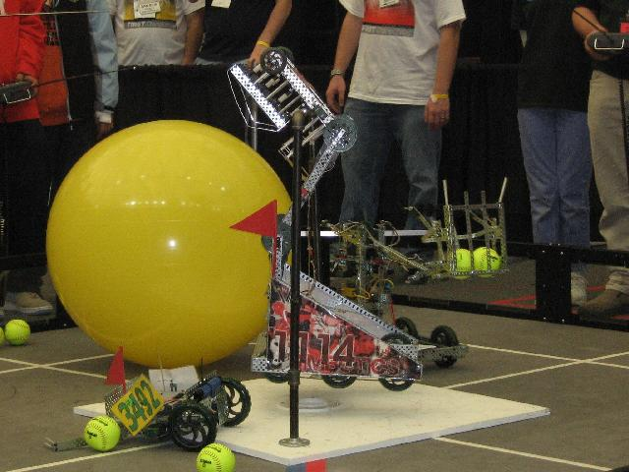
Vex robot with arm to handle tennis balls, from other competition.

Slide 29
Problems for design
Create a plan of a robot with four wheels, skid steering and a robot arm on top of it.
The arm should be able to grasp an item and transport it to other place, then put it on the floor surface or a small desk.
Assembly of such robot took about 10 hours to a high school student.

